Slide 1
HTML Tutorial-2
by
Samrat Sarkar

Slide 2
LINK, VLINK, and ALINK
These attributes control the colors of the different link states:
1. LINK – initial appearance – default = Blue.
2. VLINK – visited link – default = Purple.
3. ALINK –active link being clicked–default= Yellow.
The Format for setting these attributes is:
<BODY BGCOLOR=“#FFFFFF” TEXT=“#FF0000” LINK=“#0000FF”
VLINK=“#FF00FF”
ALINK=“FFFF00”> </BODY>

Slide 3
Using Image Background
The BODY element also gives you ability of setting an image as the document’s background.
An example of a background image’s HTML code is as follows:
<BODY BACKGROUND=“hi.gif”></BODY>

Slide 4
Break, <BR>
Line breaks allow you to decide where the text will break on a line or continue to the end of the window.
A <BR> is an empty Element, meaning that it may contain attributes but it does not contain content.
The <BR> element does not have a closing tag.

Slide 5
Break, <BR>
<HTML>
<HEAD>
<TITLE> Example Page</TITLE>
</HEAD>
<BODY>
<H1> Heading 1 </H1>
<P>Paragraph 1, <BR>
Line 2 <BR> Line 3 <BR>….
</P>
</BODY>
</HTML>
Heading 1
Paragraph 1,
Line 2
Line 3
….

Slide 6
Character Formatting
Here, you will learn how to enhance your page with Bold, Italics, and other character formatting options.
Using Character Formatting, you can
Change the color and size of your text.
Use Common Character Formatting Elements.
Align your text.
Add special characters.
Use other character formatting elements.

Slide 7
Bold, Italic and other Character Formatting Elements
<FONT SIZE=“+2”> Two sizes bigger</FONT>
The size attribute can be set as an absolute value from 1 to 7 or as a relative value using the “+” or “-” sign. Normal text size is 3 (from -2 to +4).
<B> Bold </B>
<I> Italic </I>
<U> Underline </U>
Color = “#RRGGBB” The COLOR attribute of the FONT element. E.g., <FONT COLOR=“#RRGGBB”>this text has color</FONT>
<PRE> Preformatted </PRE> Text enclosed by PRE tags is displayed in a mono-spaced font. Spaces and line breaks are supported without additional elements or special characters.

Slide 8
Bold, Italic and other Character Formatting Elements
<EM> Emphasis </EM> Browsers usually display this as italics.
<STRONG> STRONG </STRONG> Browsers display this as bold.
<TT> TELETYPE </TT> Text is displayed in a mono-spaced font. A typewriter text, e.g. fixed-width font.
<CITE> Citation </CITE> represents a document citation (italics). For titles of books, films, etc. Typically displayed in italics. (A Beginner's Guide to HTML)

Slide 9
Alignment
Some elements have attributes for alignment (ALIGN) e.g. Headings, Paragraphs and Horizontal Rules.
The Three alignment values are : LEFT, RIGHT, CENTER.
<CENTER></CENTER> Will center elements.

Slide 10
Alignment
<DIV ALIGN=“value”></DIV> Represents a division in the document and can contain most other element type. The alignment attribute of the DIV element is well supported.
<TABLE></TABLE> Inside a TABLE, alignment can be set for each individual cell.

Slide 11
Special Characters & Symbols
These Characters are recognized in HTML as they begin with an ampersand and end with with a semi-colon e.g. &value; The value will either be an entity name or a standard ASCII character number. They are called escape sequences.
The next table represents some of the more commonly used special characters.

Slide 12
Special Characters & Symbols
Special Character | Entity Name | Special Character | Entity Name
Ampersand | &amp; & | Greater-than sign | &gt; >
Asterisk | &lowast; ∗∗ | Less-than sign | &lt; <
Cent sign | &cent; ¢ | Non-breaking space | &nbsp;
Copyright | &copy; © | Quotation mark | &quot; "
Fraction one qtr | &frac14; ¼ | Registration mark | &reg; ®
Fraction one half | &frac12; ½ | Trademark sign | &trade; ™

Slide 13
Special Characters & Symbols
Additional escape sequences support accented characters, such as:
&ouml;
a lowercase o with an umlaut: ö
&ntilde;
a lowercase n with a tilde: ñ
&Egrave;
an uppercase E with a grave accent: È
NOTE: Unlike the rest of HTML, the escape sequences are case sensitive. You cannot, for instance, use &LT; instead of &lt;.

Slide 14
Additional Character Formatting Elements
<STRIKE> strike-through text</STRIKE>
DEL is used for STRIKE at the latest browsers
<BIG> places text in a big font</BIG>
<SMALL> places text in a small font</SMALL>
<SUB> places text in subscript position </SUB>
<SUP> places text in superscript style position </SUP>

Slide 15
Example
<P><STRIKE> strike-through text </STRIKE></BR>
<BIG>places text in a big font </BIG><BR>
<SMALL> places text in a small font</SMALL><BR>
<SUB> places text in subscript position </SUB>
Normal
<SUP> places text in superscript style position </SUP><BR> </P>

Slide 16
Lists
Here you will learn how to create a variety of lists.
You can
Create an unordered list.
Create an ordered list.
Create a defined list.
Nested Lists.

Slide 17
List Elements
HTML supplies several list elements. Most list elements are composed of one or more <LI> (List Item) elements.
UL : Unordered List. Items in this list start with a list mark such as a bullet. Browsers will usually change the list mark in nested lists.
<UL>
<LI> List item …</LI>
<LI> List item …</LI>
</UL>
List item …
List item …

Slide 18
List Elements
You have the choice of three bullet types: disc(default), circle, square.
These are controlled in Netscape Navigator by the “TYPE” attribute for the <UL> element.
<UL TYPE=“square”>
<LI> List item …</LI>
<LI> List item …</LI>
<LI> List item …</LI>
</UL>
List item …
List item …
List item …

Slide 19
List Elements
OL: Ordered List. Items in this list are numbered automatically by the browser.
<OL>
<LI> List item …</LI>
<LI> List item …</LI>
<LI> List item …</LI>
</OL>
List item …
List item …
List item
You have the choice of setting the TYPE Attribute to one of five numbering styles.

Slide 20
List Elements
TYPE | Numbering | Styles
1 | Arabic numbers | 1,2,3, ……
a | Lower alpha | a, b, c, ……
A | Upper alpha | A, B, C, ……
i | Lower roman | i, ii, iii, ……
I | Upper roman | I, II, III, ……

Slide 21
List Elements
You can specify a starting number for an ordered list.
<OL TYPE =“i”>
<LI> List item …</LI>
<LI> List item …</LI>
</OL>
<P> text ….</P>
<OL TYPE=“i” START=“3”>
<LI> List item …</LI>
</OL>

Slide 22
List Elements
DL: Definition List. This kind of list is different from the others. Each item in a DL consists of one or more Definition Terms (DT elements), followed by one or more Definition Description (DD elements).
<DL>
<DT> HTML </DT>
<DD> Hyper Text Markup Language </DD>
<DT> DOG </DT>
<DD> A human’s best friend!</DD>
</DL>
HTML
Hyper Text Markup Language
DOG
A human’s best friend!

Slide 23
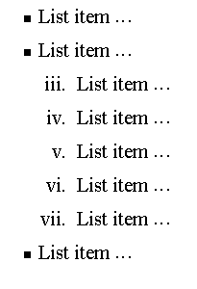
Nesting Lists
You can nest lists by inserting a UL, OL, etc., inside a list item (LI).
EXample
<UL TYPE = “square”>
<LI> List item …</LI>
<LI> List item …
<OL TYPE=“i” START=“3”>
<LI> List item …</LI>
<LI> List item …</LI>
<LI> List item …</LI>
<LI> List item …</LI>
<LI> List item …</LI>
</OL>
</LI>
<LI> List item …</LI>
</UL>

Slide 24
What will be the output?
<H1 ALIGN="CENTER">SAFETY TIPS FOR CANOEISTS</H1> <OL TYPE=“a” START=“2”> <LI>Be able to swim </LI> <LI>Wear a life jacket at all times </LI> <LI>Don't stand up or move around. If canoe tips,
<UL> <LI>Hang on to the canoe </LI> <LI>Use the canoe for support and </LI> <LI>Swim to shore </UL> </LI>
<LI>Don't overexert yourself </LI> <LI>Use a bow light at night </LI> </OL>

Slide 25
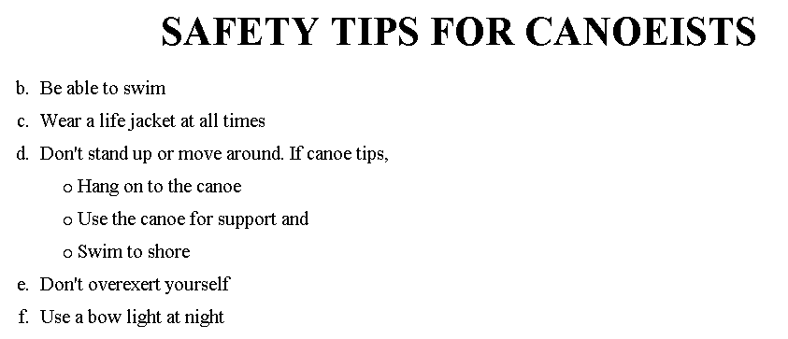
The output….

Slide 26
<H1 ALIGN="CENTER">SAFETY TIPS FOR CANOEISTS</H1>
<OL TYPE="a" START="2">
<LI>Be able to swim </LI>
<LI>Wear a life jacket at all times </LI>
<LI>Don't stand up or move around. If canoe tips,
<UL>
<LI>Hang on to the canoe </LI>
<LI>Use the canoe for support
<OL type="I" start="4">
<LI> Be careful </LI>
<LI> Do not look around</LI>
</LI> </OL>
<LI>Swim to shore
</UL> </LI>
<LI>Don't overexert yourself </LI>
<LI>Use a bow light at night </LI>
</OL>
What
will
be the
output?

Slide 27
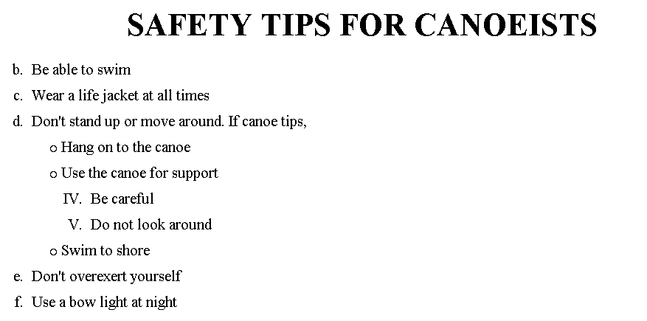
The output….

